Slide 1
Python Data Analytics
Andrew Zhang
Open Source Analytics, IBM
2019/10/26, RBS

Slide 2
Agenda
Introduction
Data Analysis with Pandas
Data Visualization with Matplotlib
Machine Learning with Scikit-learn
Bonus: Power AI Vision

Slide 3
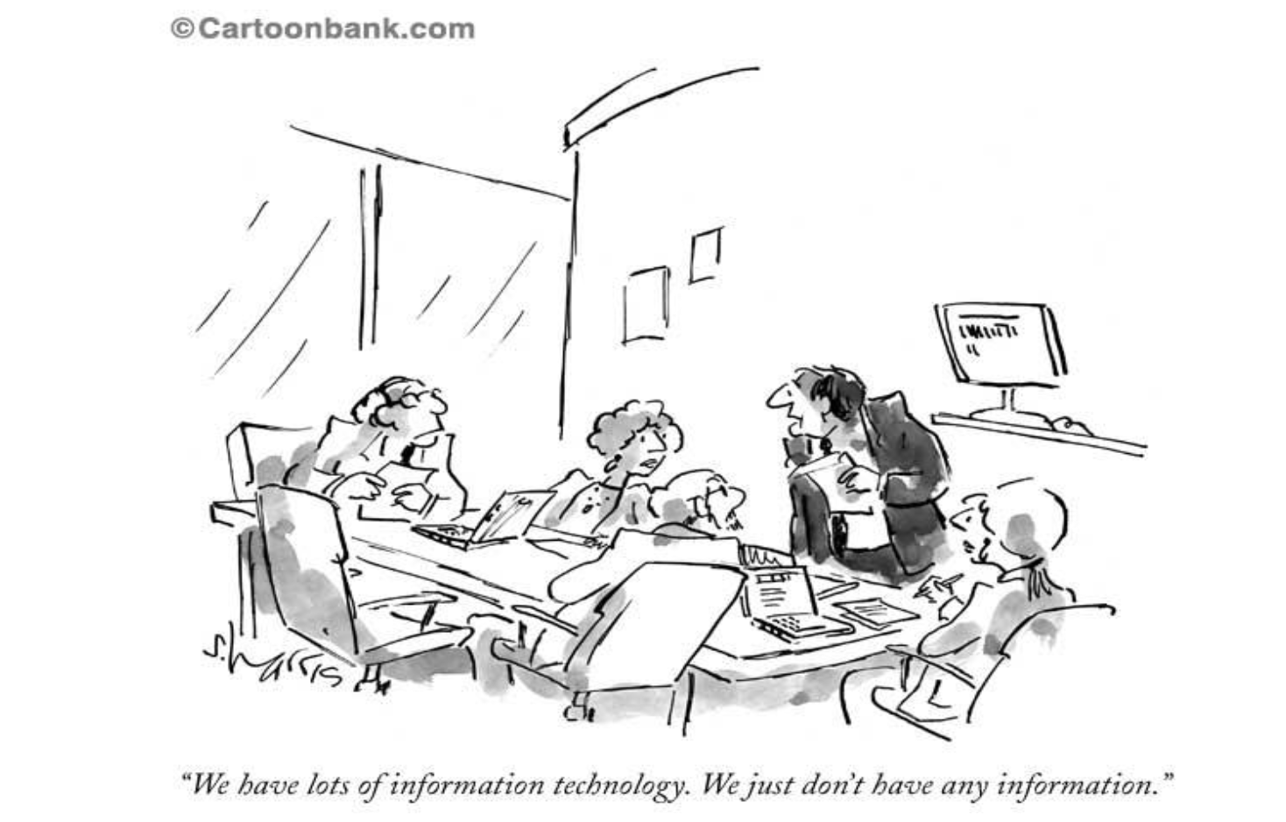
About me
Open Source
Big Data Analytics
Data Science and Machine Learning
High Performance Computing

Slide 4
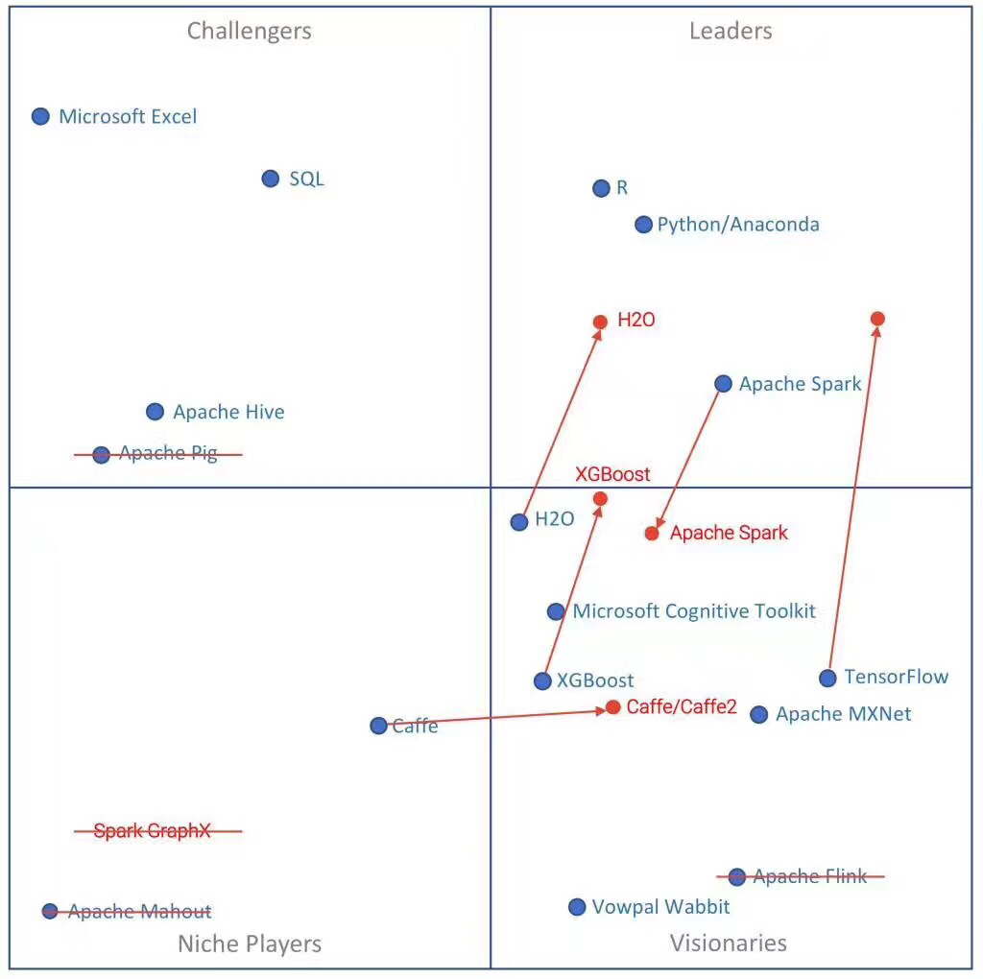
Data Analytics Magic Quadrant (2018)

Slide 5
What is the most popular programming language nowadays?

Slide 6
Introducing Python

Slide 7

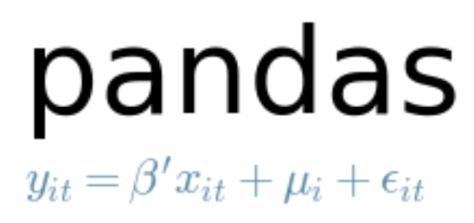


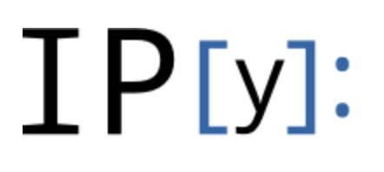

Introducing Python
"Python is powerful... and fast; plays well with others; runs everywhere; is friendly & easy to learn; is Open."
https://www.python.org/

Slide 8
Data Analysis

Slide 9
A fast and efficient DataFrame object for data manipulation
Reading and writing data : CSV and text files, Microsoft Excel, SQL databases, and the fast HDF5 format
Data alignment and handling of missing data
Reshaping and pivoting of data sets
Slicing, indexing, and subsetting of large data sets
Group by, merging and joining of data sets;
Python with pandas is in use in a wide variety of academic and commercial domains, including Finance, Neuroscience, Economics, Statistics, Advertising, Web Analytics, and more.
https://pandas.pydata.org/

Slide 10
Data Visualization

Slide 11
Python 2D plotting library which produces publication quality figures
Interactive environments with Python shell, IPython, Jupyter notebook, and web application servers
Generate plots, histograms, bar charts, scatter plots, etc., with just a few lines of code
Simple plotting pyplot module provides a MATLAB-like interface
Full control of line styles, font properties, axes properties
https://matplotlib.org/

Slide 12
Machine Learning

Slide 13
Most popular machine learning library in Python
Built on NumPy, SciPy, and matplotlib
Classification: Identifying to which category an object belongs to such as spam detection, image recognition
Regression: Predicting a continuous-valued attribute associated with an object such as energy consupmption, stock price
Clustering: Automatic grouping of similar objects into sets such as customer segmentation and grouping experiment outcome
Dimensionality reduction: Reducing the number of random variables to consider such as visualization, increased efficiency
https://scikit-learn.org/stable/

Slide 14
Lab Setup

Slide 15

Download & Install Anaconda
https://www.anaconda.com/distribution/

Slide 16
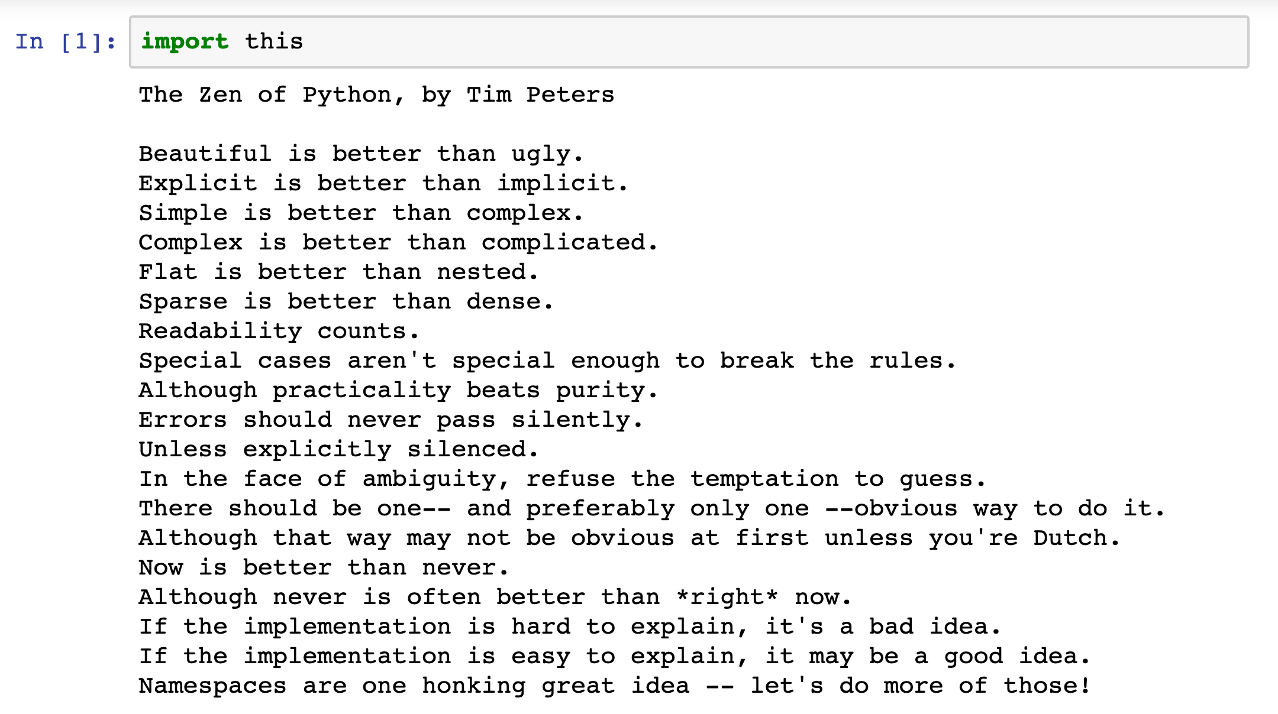
Jupyter Notebook

Slide 17
Download and Import Notebooks
https://github.com/a9zhang/RBS

Slide 18
Lab Exercises

Slide 19
Labs ( 3 hours)
Lab 1: Data Analysis with Pandas
Lab 2: Data Visualization with Matplotlib
Lab3: Machine Learning with Scikit-learn

Slide 20
Bonus

Slide 21

Machine Learning, Deep Learning and AI

Slide 22
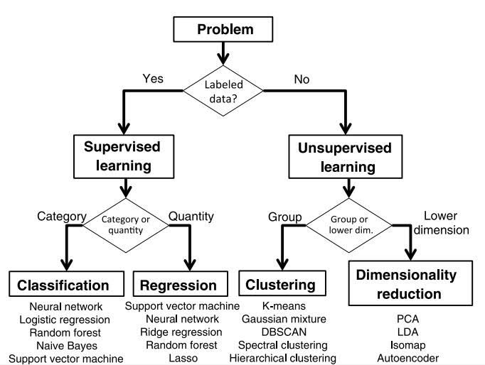
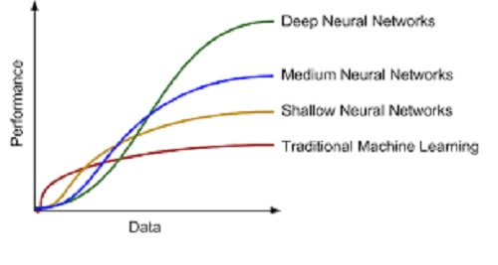
Machine Learning vs Deep Learning
Machine Learning
Traditional ML requires manual feature extraction/engineering
Feature extraction for unstructured data is very difficult
Deep Learning
Deep learning can automatically learn features in data​
Deep learning is largely a "black box" technique, updating learned weights at each layer

Slide 23
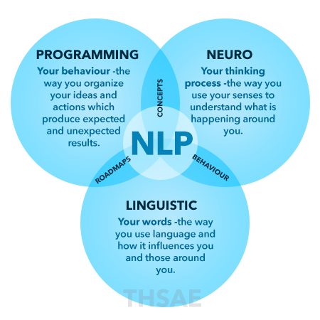
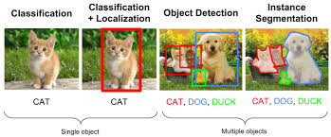
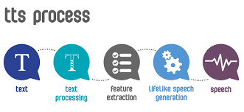
Popular Machine Learning Services
NLP
Natural Language Processing Services
Entity Extraction
Key Phrase Extraction
Sentiment Analysis
Syntax Analysis
Topic Modeling
Multiple Language Support
Parts of Speech
Visual Recognition
Object Detection
Scene Detection
Facial Recognition
Flag In-appropiate Content
Facial Analysis
Celebrity Recognition
Logo Detection
Text Recognition
Web Detection
Landmark Detection
Dominant Color Detection
Thumbnail Generation
Speech
SSML
Multiple Language
Format
Automatic Speech Recognition (ASR)
Noisy Accuracy
Machine Learning (ML) Services from Various Cloud ML Service Providers

Slide 24
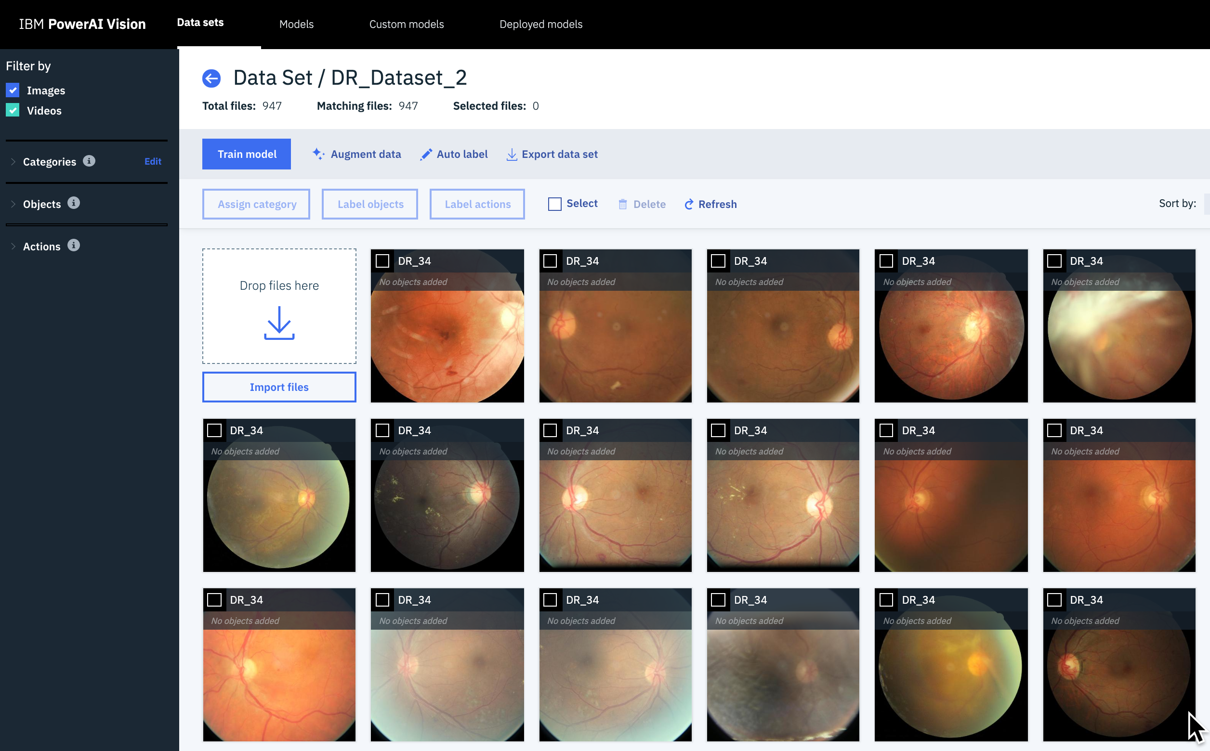
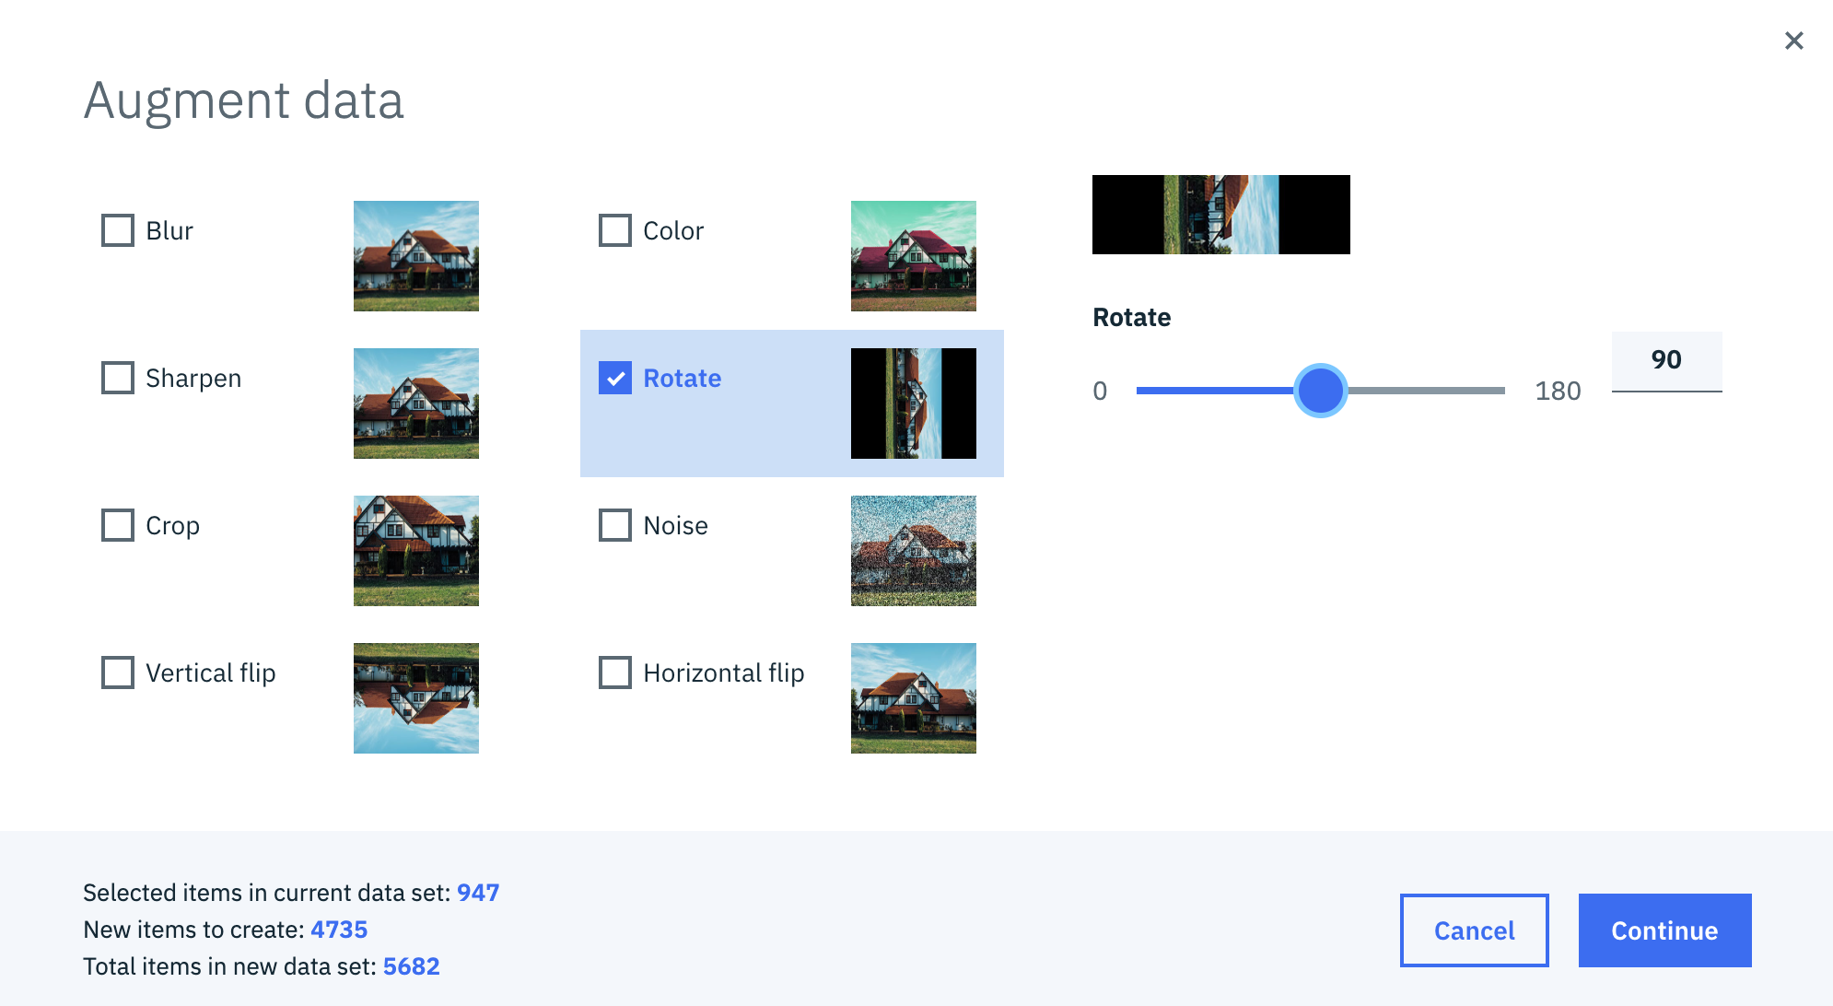
Diabetic Retinopathy Detection using Power AI Vision
35,000 + images of various classes
0 - No DR 1 - Mild 2 - Moderate 3 - Severe 4 - Proliferative DR
Data Augmentation – create more data
Resize, Crop, Rotate, Flip, Translation…

Slide 25
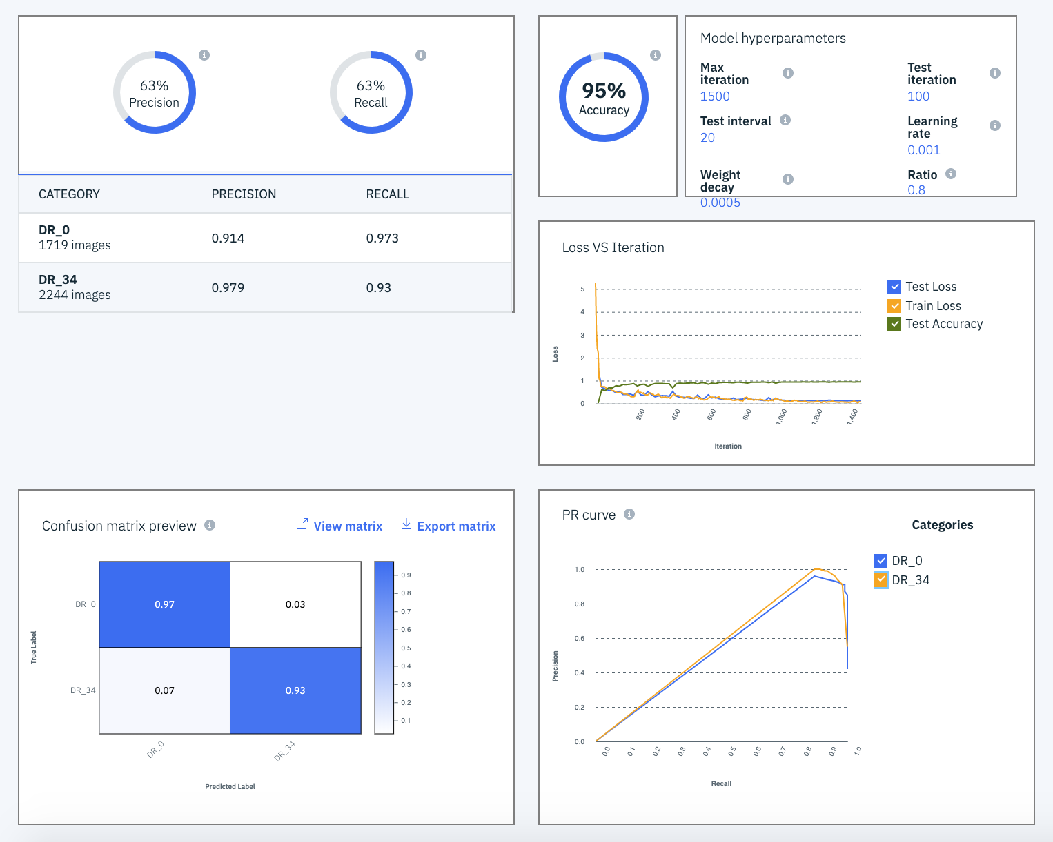
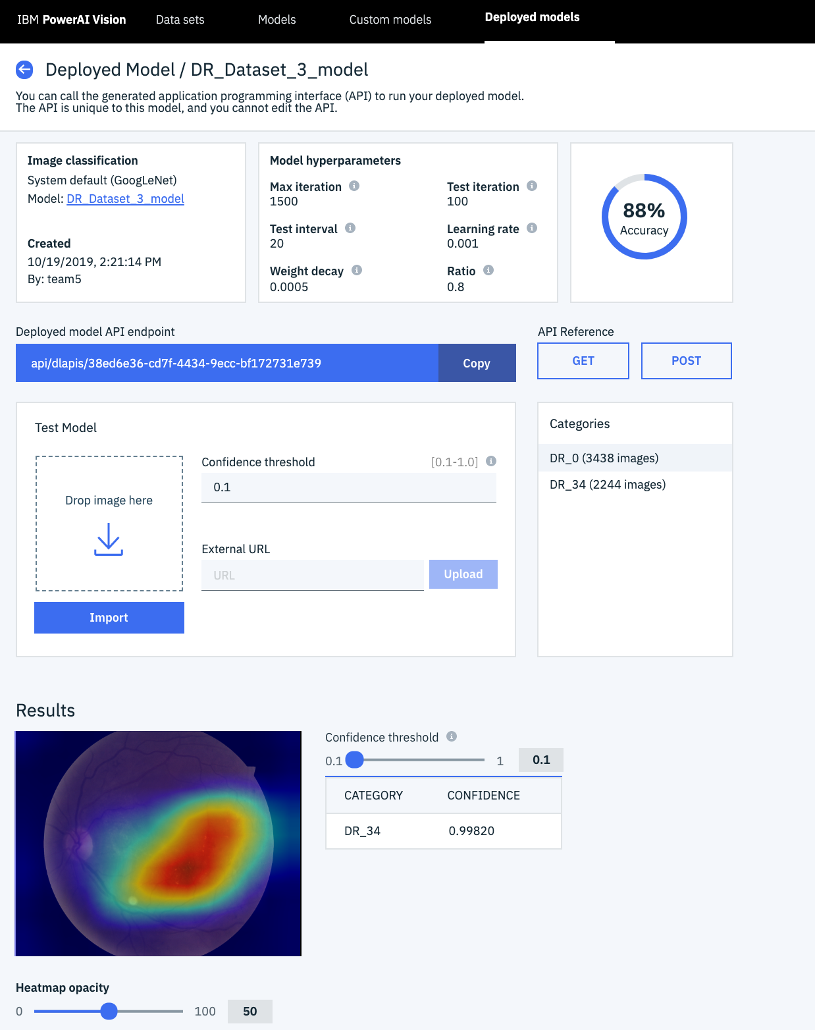
Diabetic Retinopathy Detection using Power AI Vision
Train machine learning model with high accuracy without coding
Detect new images – DR vs No_DR with a trained model

Slide 26
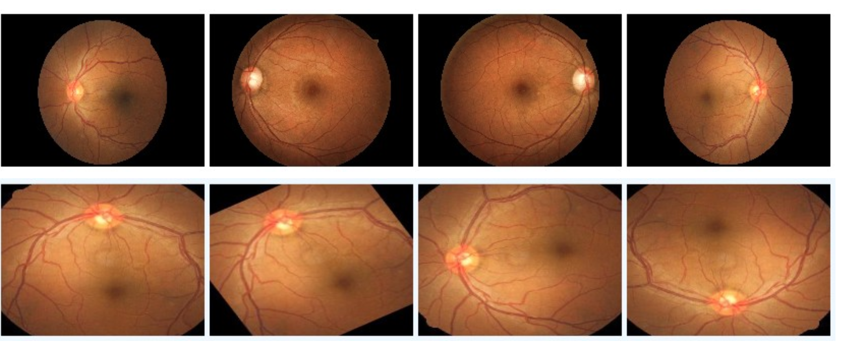
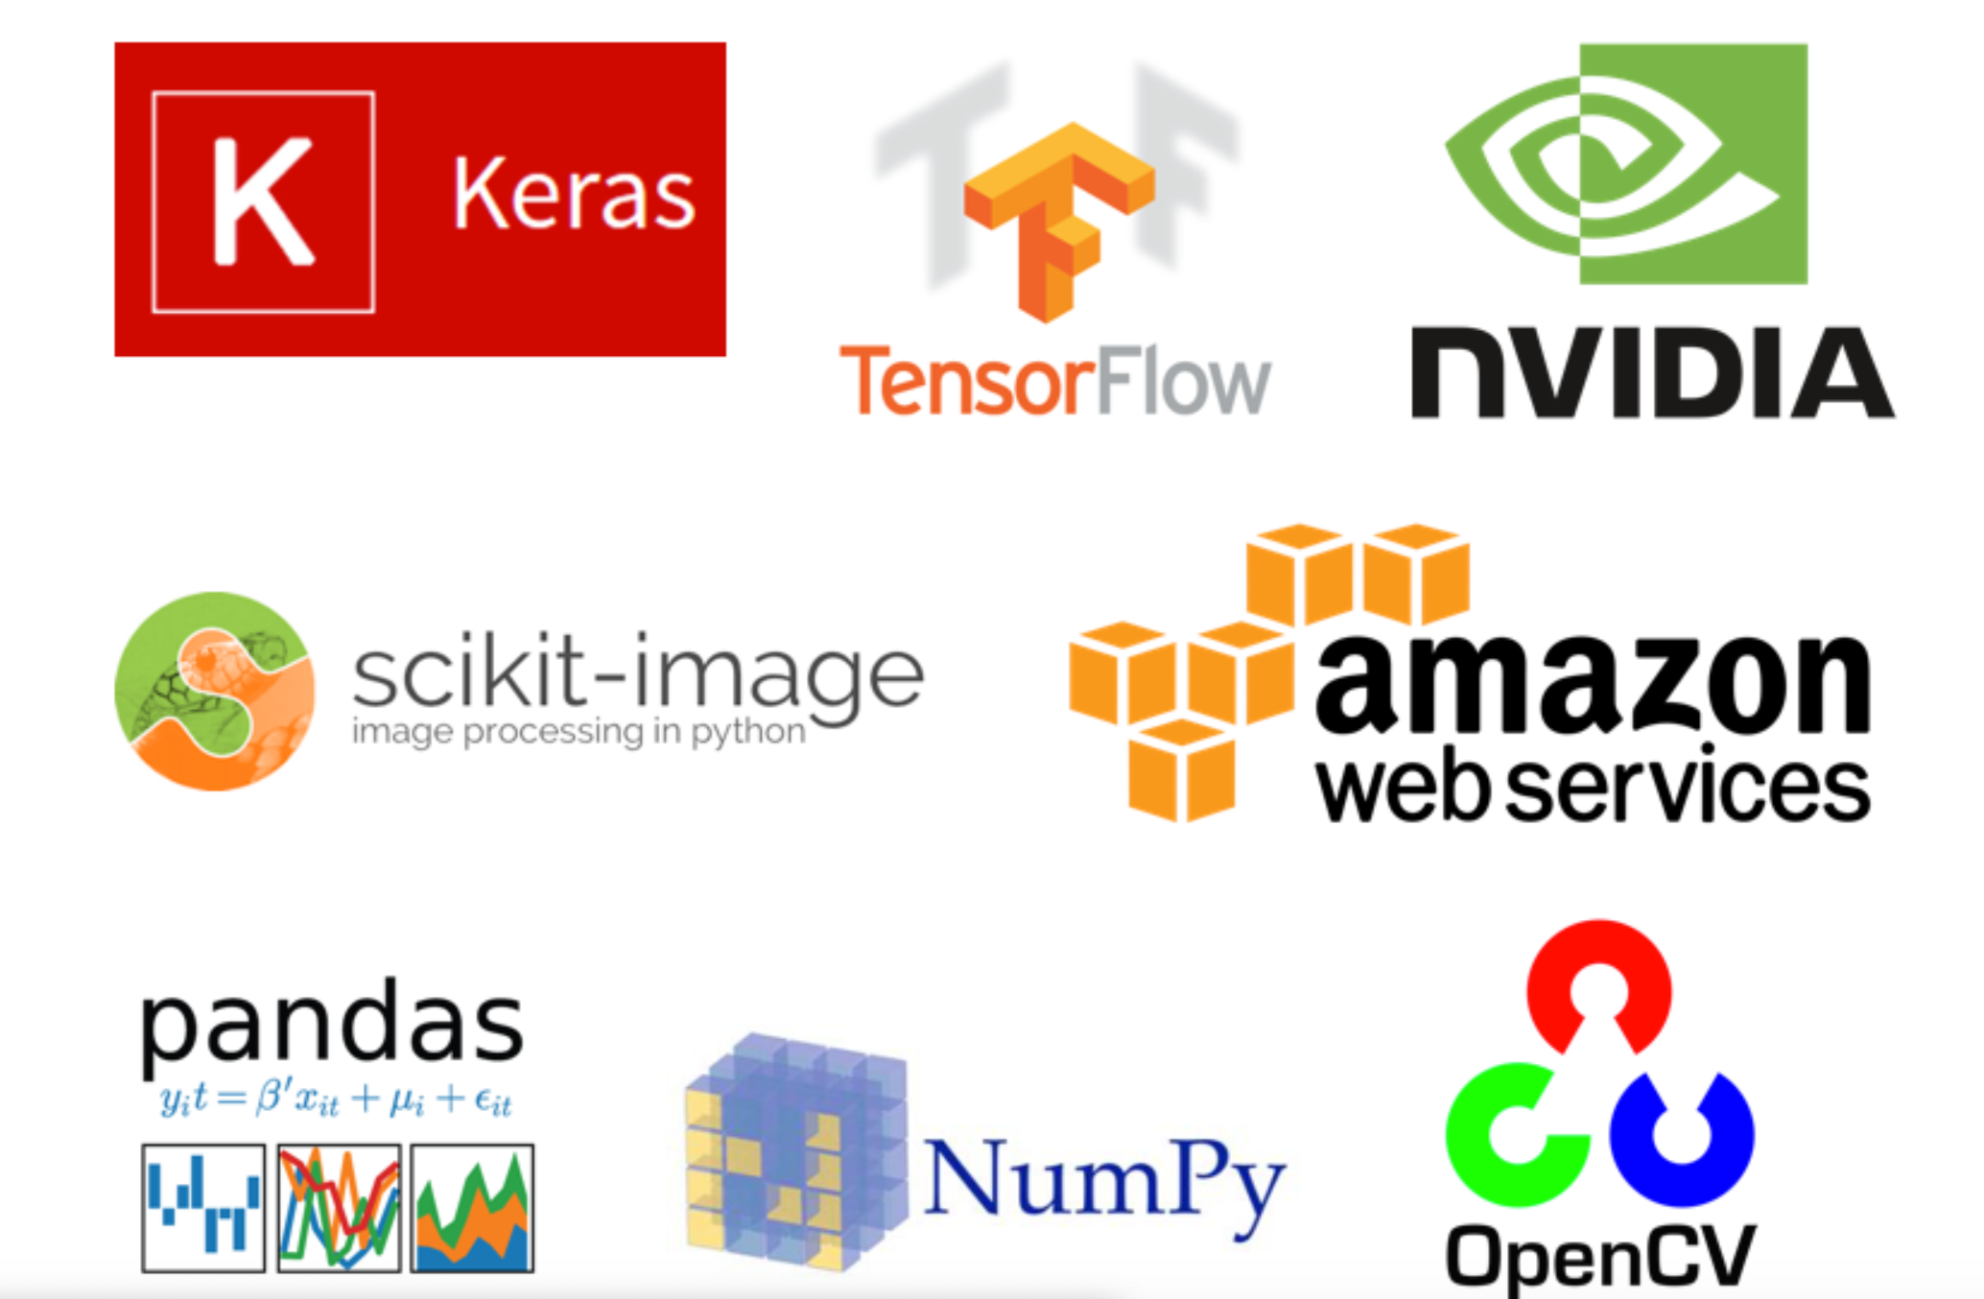
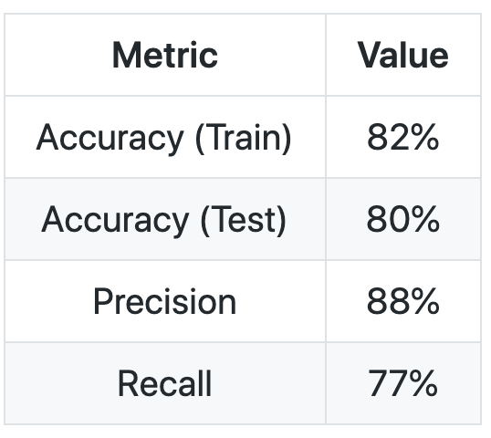
Diabetic Retinopathy Detection using Python
Python and Open Source
Exploratory Data Analysis
Crop and Resize Images on cloud
Rotate and Mirror Images
Neural Network Architecture

Slide 27
Backup Slides

Slide 28










Watson Studio
Comprehensive set of tools for the end-to-end AI workflow
Create, collaborate, deploy, and monitor
Best of breed open source & IBM tools
Code (R, Python or Scala) and no-code/visual modeling tools
Authoring Tools
Data Refinery
Model Builder
Watson API Tools
Machine Learning Runtimes
Deep Learning Runtimes
Most popular open source frameworks
IBM best-in-class frameworks
Cloud Infrastructure as a Service
Fully managed service
Container-based resource management
Elastic pay as you go CPU/GPU power
Model Lifecycle Management

Slide 29
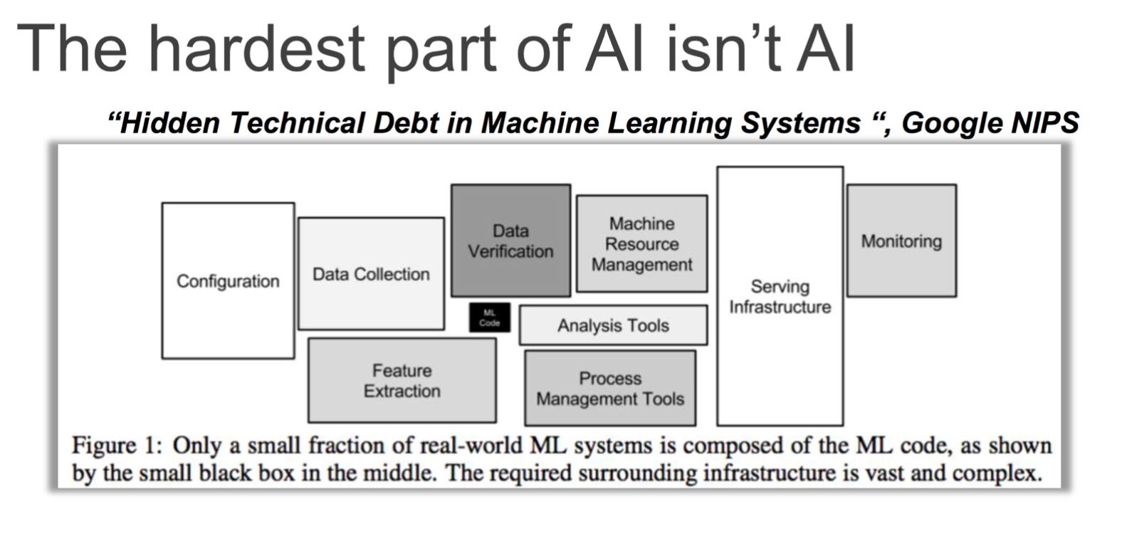
Machine Learning, Deep Learning and AI

Slide 30
Bonus
Bar Chart Racing in Python ~In roughly less than 50 lines of code

Slide 31
Pandas Introduction
Question #1: check the bottom 10 rows of data frame "df".
Question #2: Find the name of the columns of the dataframe
Question #3: You can select the columns of a data frame by indicating the name of each column, for example, you can select the three columns as follows:
dataframe[[' column 1 ',column 2', 'column 3']]
Where "column" is the name of the column, you can apply the method ".describe()" to get the statistics of those columns as follows:
dataframe[[' column 1 ',column 2', 'column 3'] ].describe()
Apply the method to ".describe()" to the columns 'length' and 'compression-ratio'.
Data Wrangling
Question #1: According to the example above, replace NaN in "stroke" column by mean.
Question #2: According to the example above, transform mpg to L/100km in the column of "highway-mpg", and change the name of column to "highway-L/100km".
Question #3: According to the example above, normalize the column "height".
Question #4: As above, create indicator variable to the column of "aspiration": "std" to 0, while "turbo" to 1.
Question #5: Merge the new dataframe to the original dataframe then drop the column 'aspiration’
Exploratory Data Analysis
Question #1: What is the data type of the column "peak-rpm"?
Question #2: Find the correlation between the following columns: bore, stroke,compression-ratio , and horsepower.
Hint: if you would like to select those columns use the following syntax: df[['bore','stroke' ,'compression-ratio','horsepower’]]
Question 3 a): Find the correlation between x="stroke", y="price".
Hint: if you would like to select those columns use the following syntax: df[["stroke","price"]]
Question 3 b): Given the correlation results between "price" and "stroke" do you expect a linear relationship?
Verify your results using the function "regplot()".
Question 4: Use the "groupby" function to find the average "price" of each car based on "body-style" ?

Slide 32
Matplotlib Introduction
Question: Plot a line graph of immigration from Haiti using df.plot()
Question: Let's compare the number of immigrants from India and China from 1980 to 2013.
Question: Compare the trend of top 5 countries that contributed the most to immigration to Canada.
Area Plots, Histograms, and Bar Plots
Question: Use the scripting layer to create a stacked area plot of the 5 countries that contributed the least to immigration to Canada from 1980 to 2013. Use a transparency value of 0.45.
Question: Use the artist layer to create an unstacked area plot of the 5 countries that contributed the least to immigration to Canada from 1980 to 2013. Use a transparency value of 0.55.
Question: What is the frequency distribution of the number (population) of new immigrants from the various countries to Canada in 2013?
Question: What is the immigration distribution for Denmark, Norway, and Sweden for years 1980 - 2013?
Question: Use the scripting layer to display the immigration distribution for Greece, Albania, and Bulgaria for years 1980 - 2013? Use an overlapping plot with 15 bins and a transparency value of 0.35.
Question: Let's compare the number of Icelandic immigrants (country = 'Iceland') to Canada from year 1980 to 2013.
Question: Using the scripting layter and the df_can dataset, create a horizontal bar plot showing the total number of immigrants to Canada from the top 15 countries, for the period 1980 - 2013. Label each country with the total immigrant count.
Pie Charts, Box Plots, Scatter Plots, and Bubble Plots
Question: Using a pie chart, explore the proportion (percentage) of new immigrants grouped by continents in the year 2013.
Question: Compare the distribution of the number of new immigrants from India and China for the period 1980 - 2013.
Question: Create a box plot to visualize the distribution of the top 15 countries (based on total immigration) grouped by the decades 1980s, 1990s, and 2000s.
Question: Create a scatter plot of the total immigration from Denmark, Norway, and Sweden to Canada from 1980 to 2013?
Question: Previously in this lab, we created box plots to compare immigration from China and India to Canada. Create bubble plots of immigration from China and India to visualize any differences with time from 1980 to 2013. You can use df_can_t that we defined and used in the previous example.

Slide 33
ML0101EN-Reg-Simple-Linear-Regression-Co2-py-v1
Practice
plot CYLINDER vs the Emission, to see how linear is their relation:
ML0101EN-1-Reg-Mulitple-Linear-Regression-Co2-py-v1
Practice
Try to use a multiple linear regression with the same dataset but this time use __FUEL CONSUMPTION in CITY__ and __FUEL CONSUMPTION in HWY__ instead of FUELCONSUMPTION_COMB. Does it result in better accuracy?
ML0101EN-2-Clas-Decision-Trees-drug-py-v1
Practice
What is the size of data?
Practice
Print the shape of X_trainset and y_trainset. Ensure that the dimensions match
In [10]:
Practice
Can you calculate the accuracy score without sklearn ?
ML0101EN-3-Clus-K-Means-Customer-Seg-py-v1
Practice
Try to cluster the above dataset into 3 clusters. Notice: do not generate data again, use the same dataset as above.
ML0101EN-4-Clas-Logistic-Reg-churn-py-v1
\Practice
How many rows and columns are in this dataset in total? What are the name of columns?
Practice
Try to build Logistic Regression model again for the same dataset, but this time, use different __solver__ and __regularization__ values? What is new __logLoss__ value?
ML0101EN-5-RecSys-Content-Based-movies-py-v1

